Slide 1
Big Mountain Resort Pricing Analysis & Recommendations

Slide 2
Problem statement
How can Big Mountain Resort optimize ticket price to reflect it’s industry-leading infrastructure and experience?
How can costs be cut or prices increased to cover the $1.54 million cost of the new ski lift?
What investments and future development can be done to increase profits even further?

Slide 3
Recommendations and key findings
Increase ticket prices before the coming season by at least $4.48 up to $14.87 per person.
Adopt the second plan to increase revenue by building a ski lift 150 higher than the current highest.

Slide 4
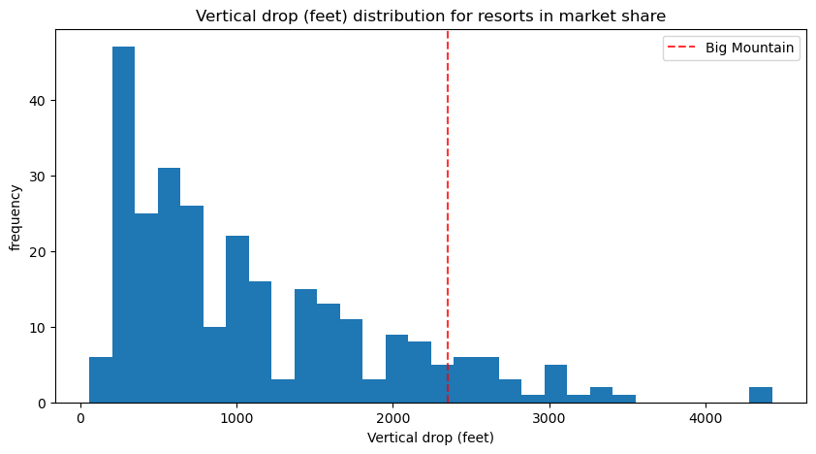
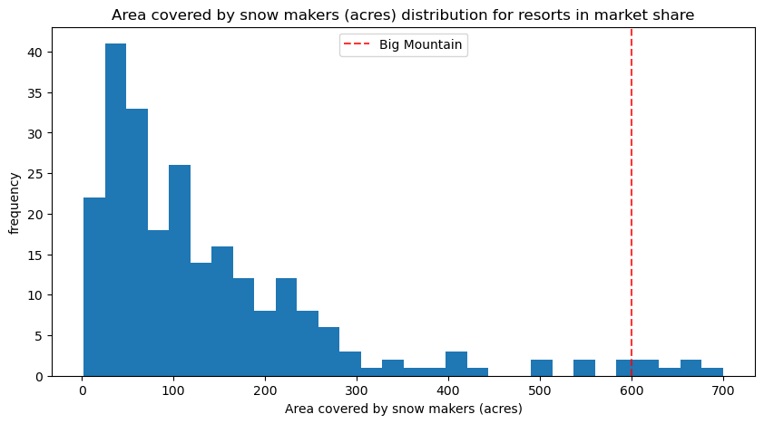
Big Mountain is an industry leader across many metrics which drive ticket prices.

Slide 5
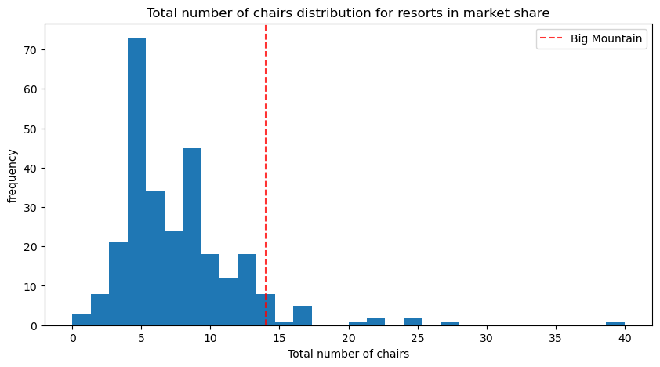
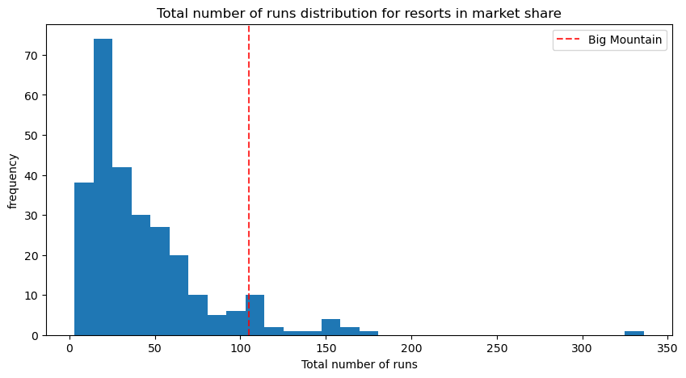
Big Mountain is an industry leader across many metrics which drive ticket prices.

Slide 6
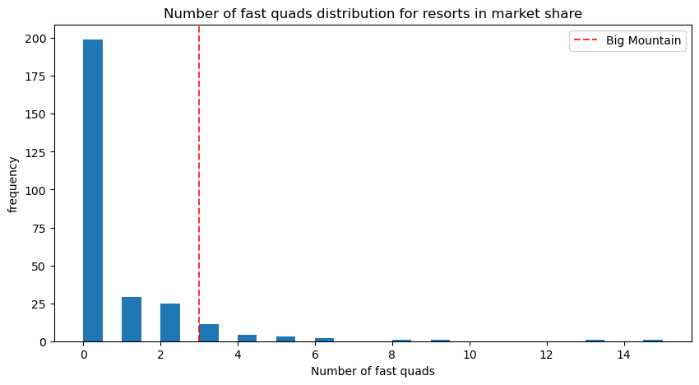
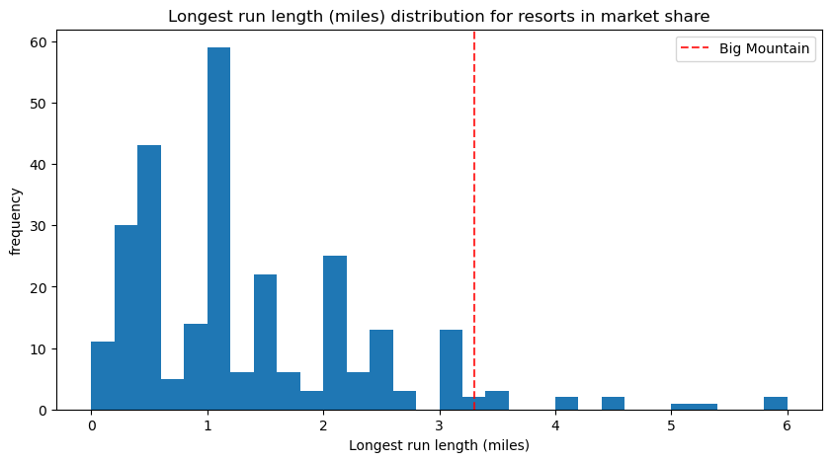
Big Mountain is an industry leader across many metrics which drive ticket prices.

Slide 7
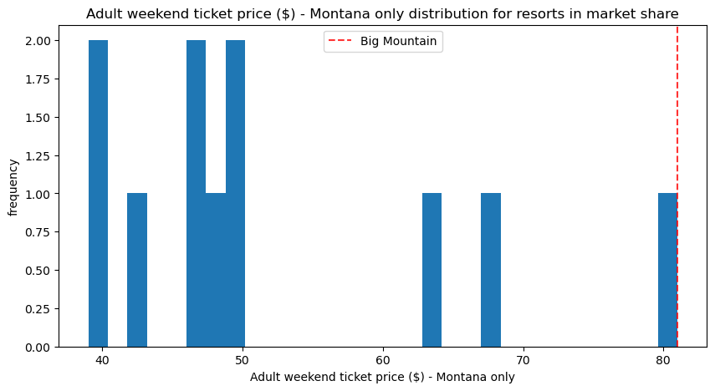
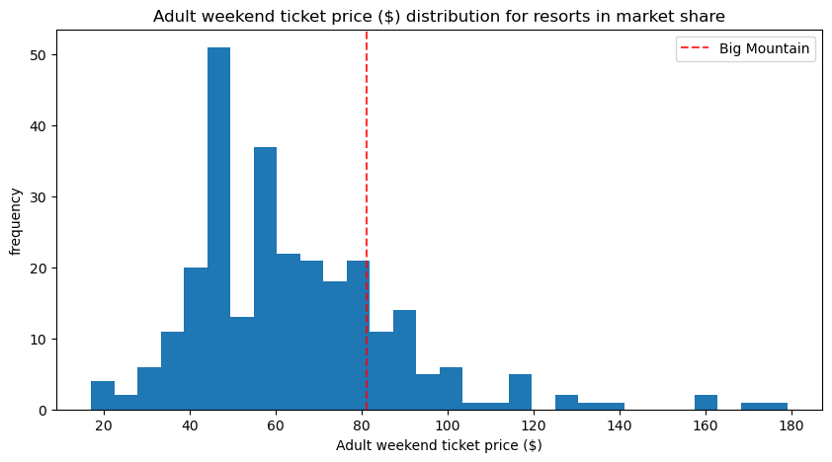
Current Market Standing
Big Mountain is the most expensive in Montana, but not in the general market

Slide 8
Conclusion
Big Mountain is currently underpriced relative to similar resorts in the market.
Model does not consider changes to visitor numbers, which should be considered carefully.
Closing a few runs can reduce costs without significantly impacting price, but needs to be investigated further.
Increasing things like Runs, Area covered by Snow Makers, Vertical Drop, and longest run length can justify raising ticket price.

